Slide 1
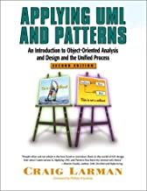
Domain Models
From Larman, Chapter 9
This is one of the most important chapters in the book.

Slide 2
What is a Domain Model?
Model of the problem domain, showing concepts, important attributes, and relationships.
Not a software model.

Slide 3
Concepts in "Make a Sale" for a Point of Sale (POS) Applicaton
Register
Item
Store
Sale
Sales
Cashier
Customer
Ledger
LineItem
Cash
Product
Product
Payment
Catalog
Description

Slide 4
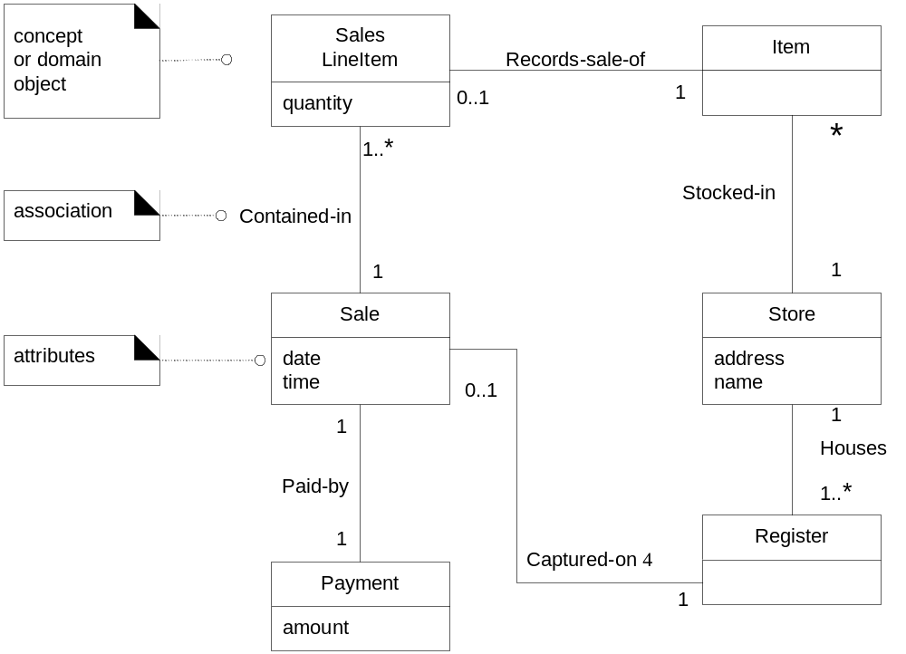
Domain Model for POS based on "Make a Sale"

Slide 5
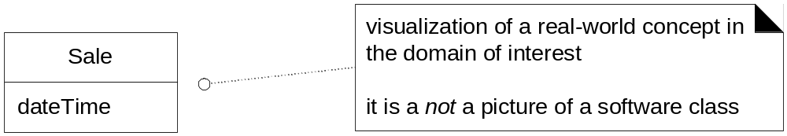
A Domain class

Slide 6
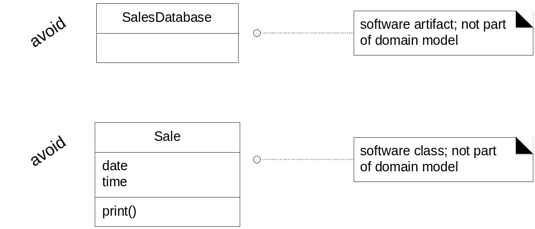
Not a Domain level class

Slide 7
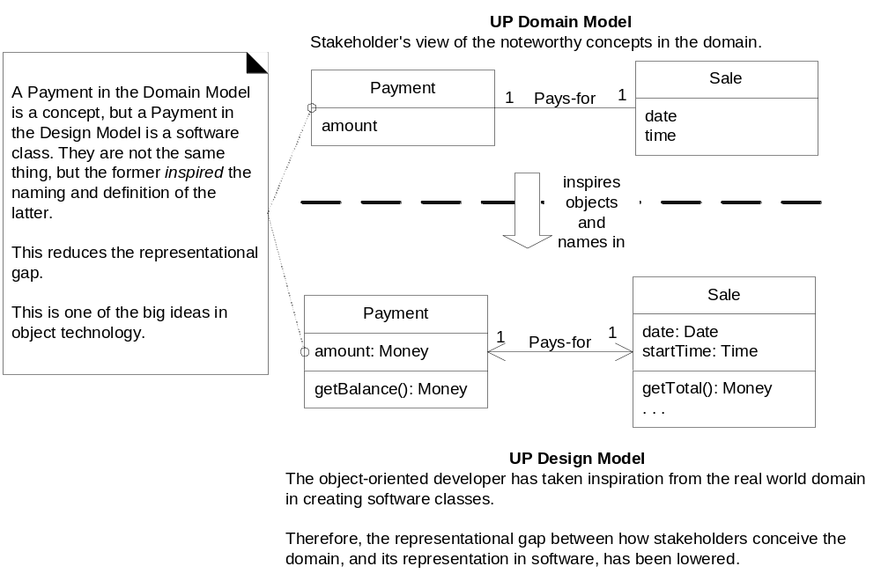
Relation between Domain and Design Model

Slide 8
3 Techniques to Discover Domain Classes
1. Look for noun phrases in User Stories
2. Use a category list
3. Use a similar existing project

Slide 9
Conceptual Category List
Table 9.1 on Larman page 140-141.
Business transactions
Product or service related to transaction
where is transaction recorded?
Catalogs
roles of people related to actors in UC

Slide 10
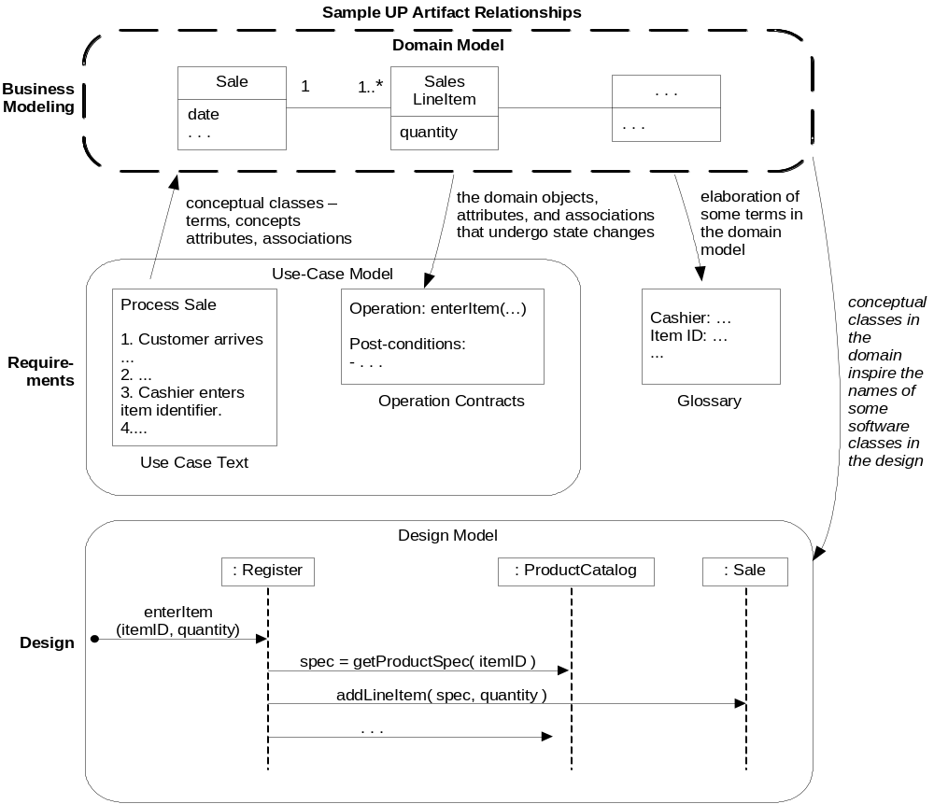
Design Documents for "Make a Sale"

Slide 11
Domain Model for Monopoly Game

Slide 12
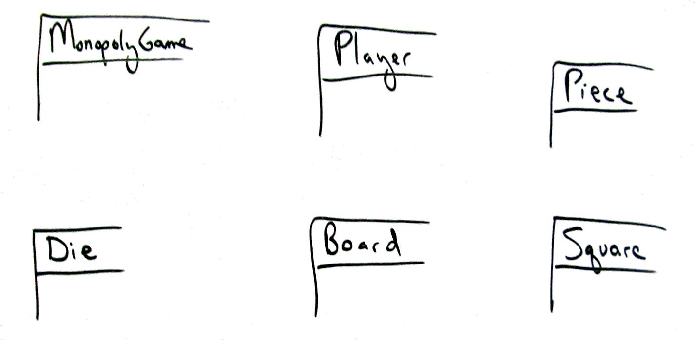

Don't try to be beautiful or complete
What is missing here?

Slide 13
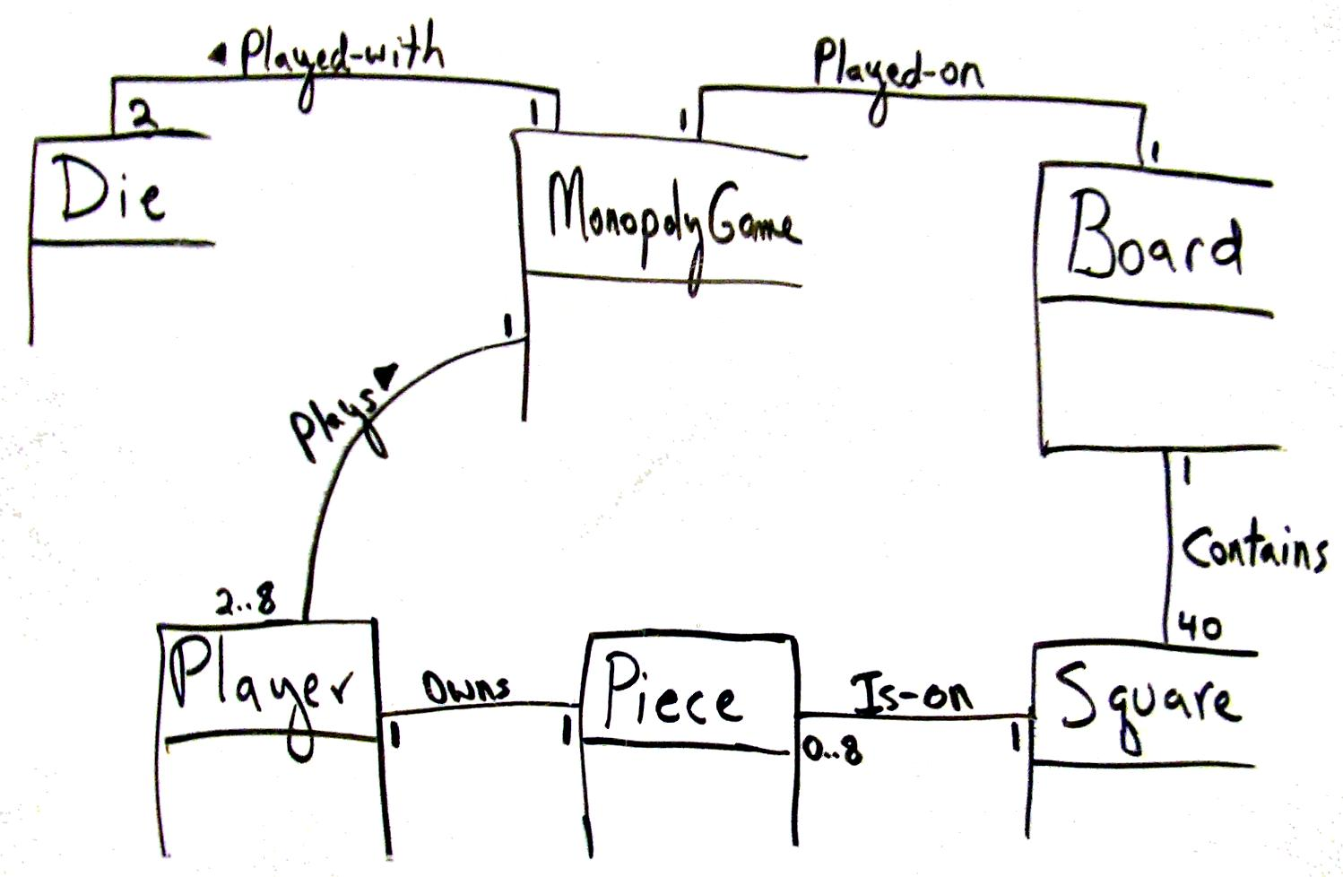
Express relationships

Slide 14
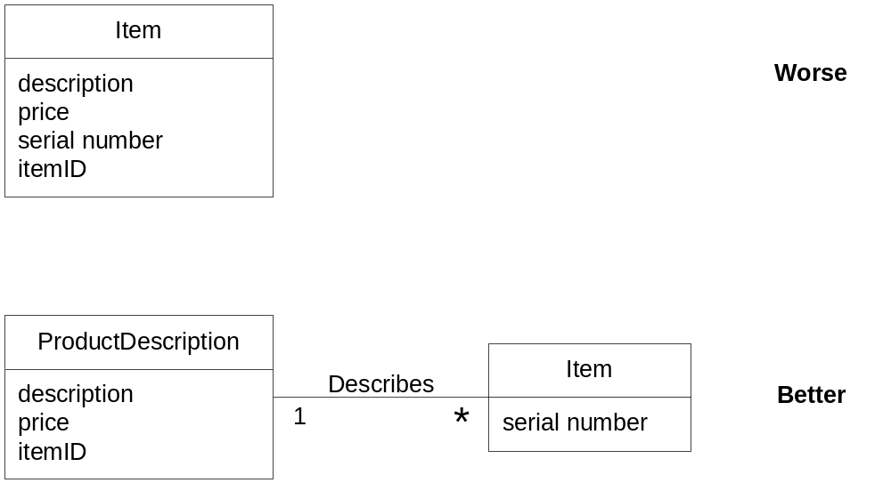
Prefer Associations over attributes

Slide 15
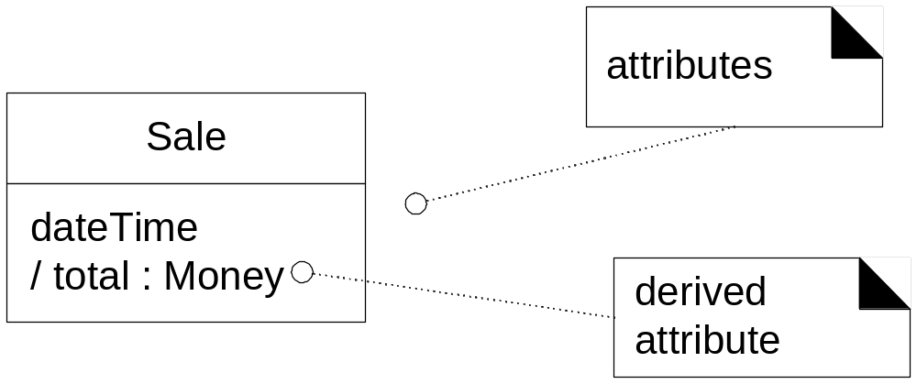
OK to show "derived" attributes

Slide 16
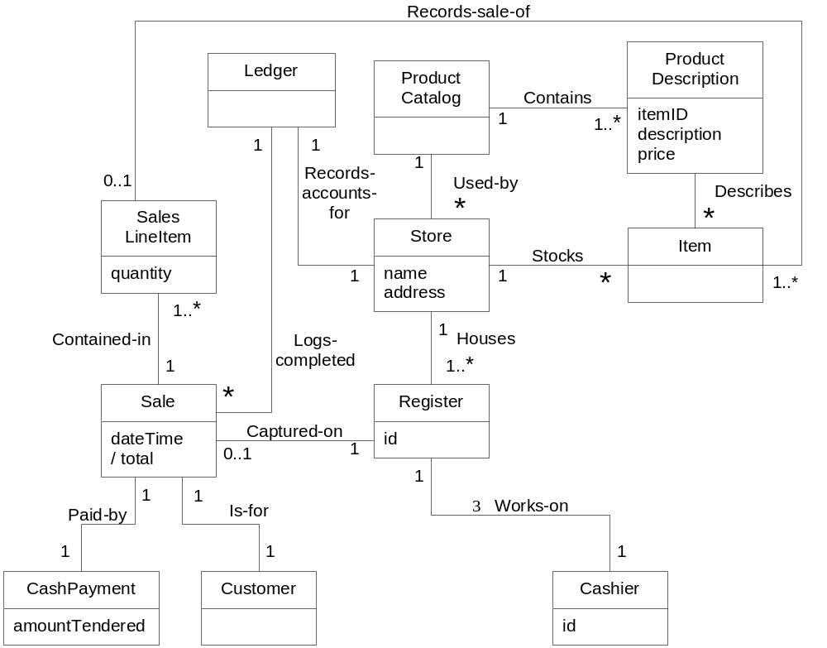
After first domain modeling session...

Slide 17
Your Turn
Analysis of your Use Cases
Use a category list
Don't be influenced by what other teams are doing – design for yourself
Similar project?

